Slide 1

CRUDE OIL PRICE PREDICTION

Slide 2



Shaikh Banisha Begum
1
Vikraj Shambhu
GROUP MEMBERS
Astika Urmaliya
Shashank Patil
Unnati Kalmase

Slide 3




Exploratory Data Analysis
1
2
Visualization
OBJECTIVE
3
Model budling
4
Deployment

Slide 4
Objective
Oil is a product that goes completely in a different direction for a single market event as the oil prices are rarely based on real-time data, instead, it is driven by externalities making our attempt to forecast it even more challenging As the economy will be highly affected by oil prices our model will help to understand the pattern in prices to help the customers and businesses to make smart decisions.

Slide 5
Libraries
Which we have used in the whole project
import pandas as pd import numpy as np
import matplotlib.pyplot as plt from sklearn import datasets
from sklearn.model_selection import train_test_split from sklearn.linear_model import LinearRegression import statsmodels.formula.api as smf
from sklearn import preprocessing
from sklearn.model_selection import KFold
from sklearn.model_selection import cross_val_score from sklearn.ensemble import RandomForestClassifier from sklearn.ensemble import RandomForestRegressor from sklearn.ensemble import GradientBoostingRegressor from sklearn.metrics import r2_score,mean_squared_error)
from statsmodels.tsa.seasonal import seasonal_decompose
from statsmodels.tsa.arima.model import ARIMAfrom statsmodels.tsa.statespace.sarimax import SARIMAXfrom statsmodels.tsa.holtwinters import ExponentialSmoothing
from prophet import Prophet

Slide 6
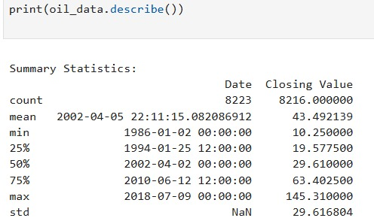
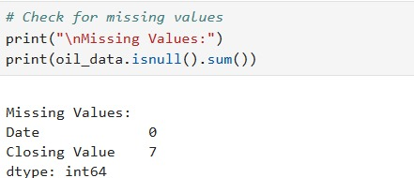
EXPLORATORY DATA ANALYSIS
STATISTICS SUMMARY
MISSING VALUES OR NULL VALUES

Slide 7
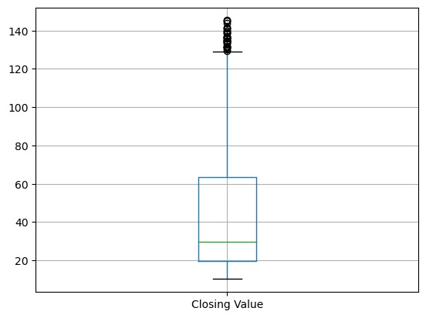
outliers

Slide 8
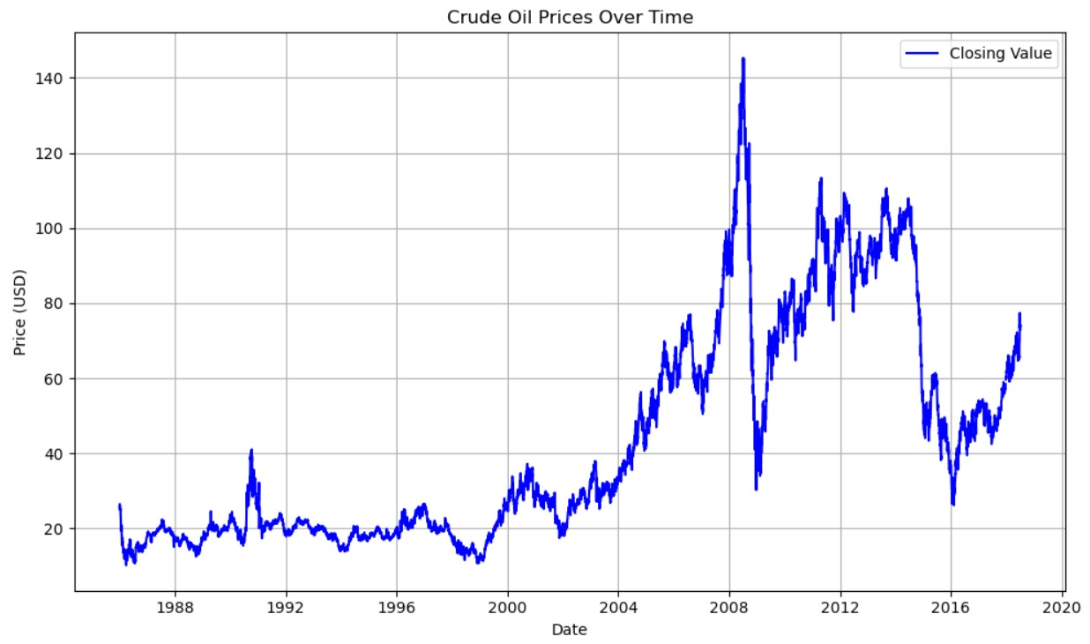
VISUALIZATION

Slide 9
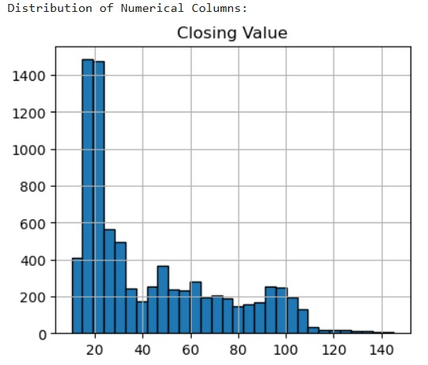

Slide 10
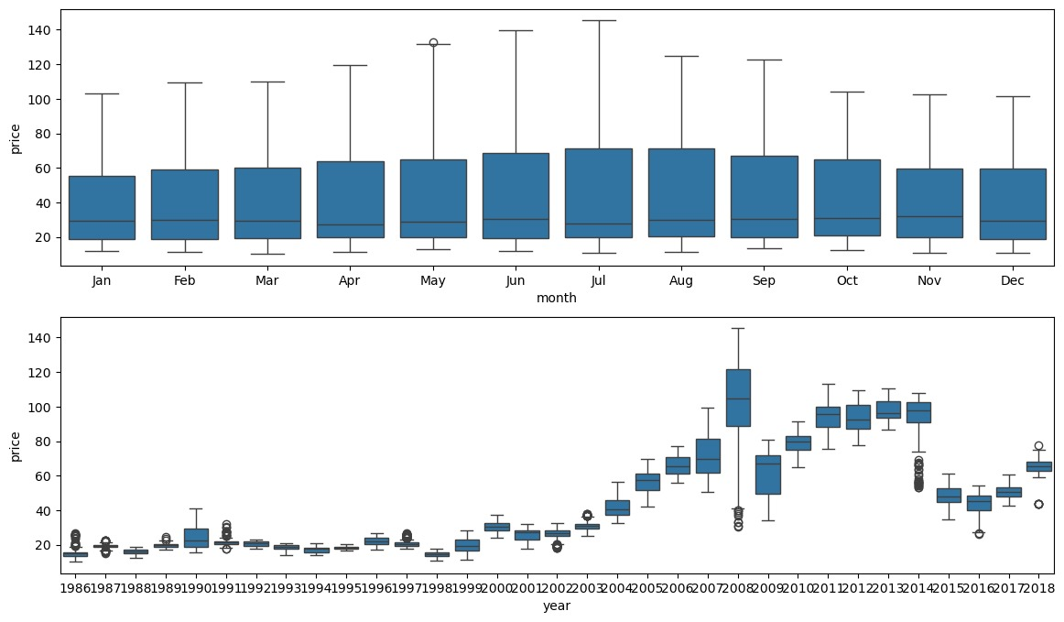

Slide 11
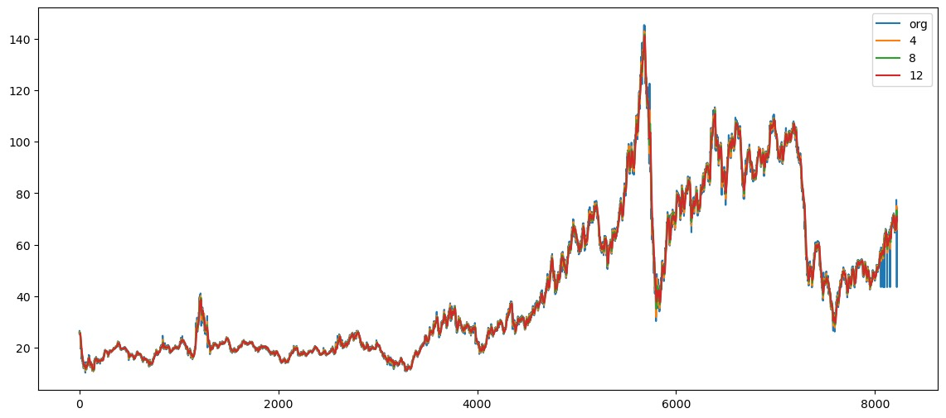

Slide 12
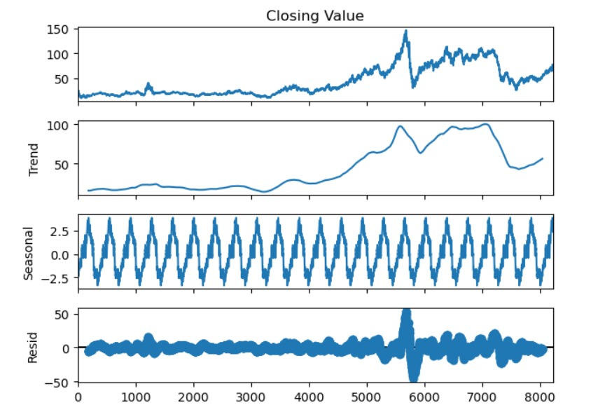

Slide 13




MODEL BUILDING
R^2 values of all the models
ARIMA
RMSE VALUE:37.7331
SARIMA
RMSE VALUE:47.6054
1
2
FB PROPHET
RMSE VALUE: 41.0911
EXPONENTIAL SMOOTHING METHOD
RMSE VALUE:47.7151
3
4
MULTIPLICATIVE ADDITIVE SEASONALITY
RMSE VALUE:41.2324
5
Based on the performance metrics, the ARIMA model is the best choice for forecasting future values as it has the lowest error ( RMSE) and the highest R² value.

Slide 14
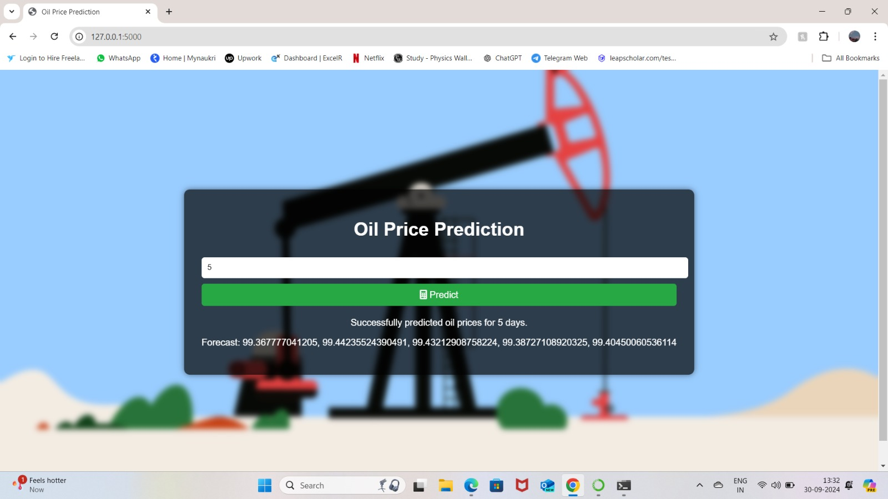
DEPLOYMENT

Slide 15
THANK YOU

